Slide 1
OPER 618 Lesson 13 BLPP – A Metaheuristic Approach Robbins, M. J. & Lunday, B.J. (2016). A Bilevel Formulation of the Pediatric Vaccine Pricing Problem. European Journal of Operational Research, 248(2), 634-645.
Dr. Brian J. Lunday
Office: Rm 201E, Bldg 641

Slide 2




Motivation(s)
www.who.int
Center for Accountability in Science
www.katehon.com
www.heatherrobinson.net

Slide 3
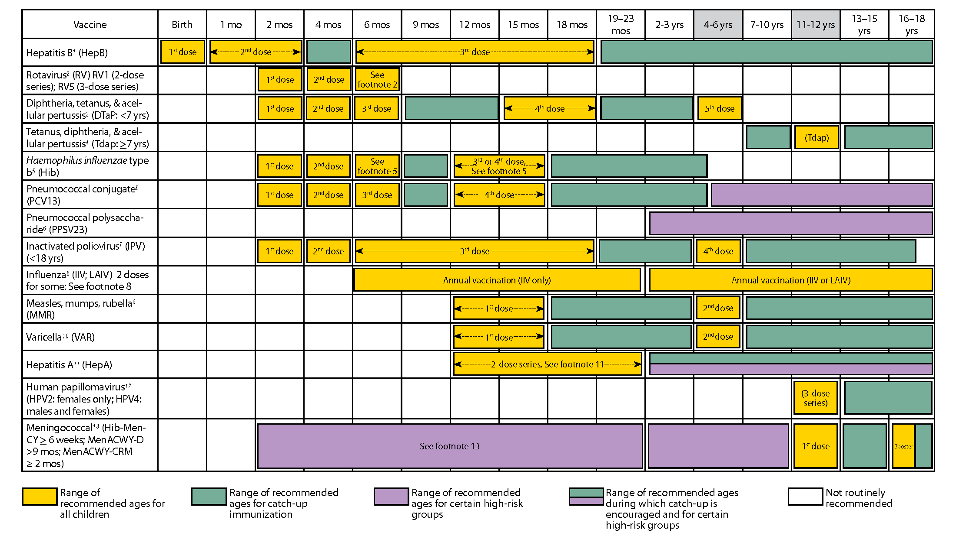
Background
Childhood vaccinations are important
~4M children born each year in the U.S.
Vaccines save lives
Vaccination schedules can be complex
Up to 29 separate injections to meet the
Recommended Childhood Immunization
Schedule (RCIS)
The private vaccine market is competitive
43% of the market is private
Only 3 vaccine manufacturers produce >1 childhood vaccine
Customers act rationally to save money
Vaccination capabilities make decisions more complex
Monovalent vs. multivalent vaccines

Slide 4
Related Work on Vaccine Pricing
Developing a minimum cost formulary
Weniger et al. (1998)
Jacobson et al. (1999)
General vaccine formulary selection problem
Hall et al. (2008)
Maximum inclusion price identification
Sewell et al. (2001)
Sewell and Jacobson (2003)
Jacobson and Sewell (2003)
Jacobson et al. (2005)
Single vaccine pricing to maximize expected revenue
Robbins et al. (2010)
Monopsonistic vaccine pricing to meet a reserved industry profits
Robbins and Jacobson (2011)
Competitive vaccine pricing strategies via Bertrand models for oligopolies
Robbins et al. (2014)
Behzad et al. (2015)

Slide 5
Problem Statement
For a pediatric vaccine manufacturer in a private market with competitors having fixed vaccine prices, set vaccine prices to maximize profit, given that a customer will construct a vaccine formulary to minimize their costs while meeting the Recommended Childhood Immunization Schedule (RCIS).

Slide 6
The RCIS
We examine selected diseases with vaccines in the competitive market
Immunization time periods, t∈T
t=2
t=5
t=1
t=3
t=4
t=6
d=2
d=1
Diseases
d∈D
d=3
d=4

Slide 7
Competing Manufacturers’ Vaccine Data (2015)
Manufacturer | Vaccine v∈V,V | DTaP (d=1) | HepB (d=2) | HiB (d=3) | IPV (d=4) | Cost to Produce ($) C_{v} | Cost to Administer ($) F_{v} | Current Price ($) P_{v}
GlaxoSmithKline | Infarix® | X |  |  |  | 3.15 | 0.25 | 21.44
 | Engerix® |  | X |  |  | 1.45 | 0.25 | 21.37
 | Kinrix® | X |  |  | X | 4.00 | 0.25 | 48.00
 | Pediarix® | X | X |  | X | 5.05 | 0.25 | 70.72
Merck | PedvaxHiB® *** |  |  | X |  | 1.45 | 0.75 | 22.769
 | Recombivax HB® |  | X |  |  | 1.45 | 0.75 | 23.204
Sanofi Pastuer | Daptacel® | X |  |  |  | 3.15 | 0.75 | 25.98
 | ActHIB® |  |  | X |  | 1.45 | 0.75 | 26.21
 | IPOL® |  |  |  | X | 1.45 | 0.75 | 27.44
 | Pentacel® | X |  | X | X | 5.05 | 0.75 | 80.43
 | n_{d} | 5 | 3 | 4 | 4

Slide 8
Bilevel MINLP Formulation
In each time period and for each vaccine, the customer decides whether to make a purchase. (X is for the manufacturer’s vaccines v∈V. Y is for the competitor’s vaccines v∈V.)
For each disease and each required dosage, the customer picks an appropriate vaccine in a suitable time period.
(I, J, S, and variants thereof for the competitors are indicator parameters to identify suitability.)
Side constraints address the Merck Effect. For example…
A customer minimizes the costs of purchasing (P_{v}, P_{v}) and administering (F_{v}, K) the selected vaccines.
(Q-parameters typically equal 1.)
A manufacturer maximizes profit.

Slide 9
Some Common Methodologies for Bilevel Programming Problems
Relax the integrality restrictions and take the dual of the lower level (LL) problem.
This only works for Stackelberg games (i.e., zero-sum), wherein the opponents seek to min-max or max-min the same objective function.
Relax the integrality restrictions and replace the LL problem with its KKT optimality conditions
The constraint matrix for the LL problem is not TU.
Enumerate upper level (UL) solutions, solving the LL problem for each.
The upper level (UL) DVs are neither discrete nor bounded.
Represent the LL objective as a constraint, bound it from above, and apply the ε-constraint method.
The resulting formulation is a bilinear (non-convex) MINLP.
There are no established methods to optimally solve bilevel programming problems having continuous UL DVs and (discrete) LL DVs.
Optimization vs. “Practical Optimization”

Slide 10
Game Tree Representation for the Bilevel Programming Problem
Extensive Form Game with Discrete Sets of Strategies
If the manufacturer had a countably finite number of strategies, we could enumerate the game tree.
Extensive Form Game with Continuous Sets of Strategies
Because the manufacturer has an infinite number of strategies, a different approach is warranted.

Slide 11
Relation the Game Theoretic Representation to the BLPP Solution
Given an extensive form game, the subperfect Nash equilibrium corresponds to the optimal solution to the bilevel programming problem.
This occurs when the manufacturer won’t benefit by changing prices and the customer won’t benefit by changing vaccines.
The SPNE does exist, consisting of UL and LL solutions.
Finding it is non-trivial for this structure.

Slide 12
Consider the UL Problem for a Manufacturer with 2 Vaccines to Price
For an UL solution (P₁,P₂), we can solve the LL optimally to find the best response (X*,Y*).
For fixed prices, the LL problem is a ZOIP.
Each UL solution has a best response LL solution.
The UL region can be considered as “partitioned” among best LL solutions.
Changing the UL solution may change the optimal LL solution.
These partitions cannot be readily mapped.
A given UL solution is not necessarily the best UL solution for a corresponding LL solution.
Search is necessary
Even if it were, we might not be finding an UL solution for which the corresponding best LL solution is part of the SPNE.
Robust sampling is necessary
Note: displayed search directions are notional.
Notes:
Of note, not every LL solution need be a response to an UL solution.
We could enumerate feasible LL solutions.
However, we can’t readily identify an UL solution that corresponds to a given LL solution.

Slide 13
Methodologies Examined
Heuristic H1 – Latin Hypercube Sampling (LHS)
Assumes an upper bound on prices (2 x current market price) and improves the likelihood of finding the SPNE via a robust sampling of 10, 100, 1000 UL solutions.
Heuristic H2 – LHS with local Nelder-Mead Search
For each sampled price point, finds a locally optimal price point the corresponding to the LL-optimal solution.
i.e., how much money can the manufacturer make by increasing prices without forcing the customer to change their decision?
Leverages a simplex having |V|+1 dimensions.
Heuristic H3 – LHS with Local Cyclic Coordinate Search
Same as H2, via a different search method.
Cyclically searches to increase each vaccine price (i.e., coordinate direction).
For each coordinate direction, conducts sequential searches using iteratively smaller discrete step sizes.
Note: Also tried the Hooke-Jeeves Method, but without a demonstrated improvement.

Slide 14
Sample Results – Profits (GlaxoSmithKline)
Examined for various levels of injection cost, K, due to parametric uncertainty
Heuristic H3 with ψ=100 or ψ=1000 was superlative
Can attain a minimum, average, and maximum increase in profit of 28.7%, 30.3%, and 34.8% per child over current price mechanisms
 | Current | H1 | H1 | H1 | H2 | H2 | H2 | H3 | H3 | H3
K=6.79 |  | ψ=10 | ψ=100 | ψ=1000 | ψ=10 | ψ=100 | ψ=1000 | ψ=10 | ψ=100 | ψ=1000
Profit ($) | 231.84 | 209.65 | 214.05 | 259.54 | 212.65 | 217.05 | 262.64 | 264.32 | 298.44 | 298.44
BR Gap (%) | 22.32 | 29.75 | 28.28 | 13.03 | 28.75 | 27.27 | 12 | 11.43 | 0 | 0
LCF ($) | 421.84 | 412.15 | 394.3 | 471.79 | 415.15 | 397.3 | 474.89 | 488.45 | 488.44 | 488.44
# IPs solved |  | 10 | 100 | 1000 | 70 | 712 | 7334 | 2189 | 23532 | 228806
CPU Time (sec) |  | 0.156 | 1.326 | 13.525 | 9.704 | 26.286 | 111.868 | 32.475 | 375.811 | 4340.99
K=9.31
Profit ($) | 231.84 | 209.65 | 214.05 | 260.64 | 212.65 | 217.05 | 262.64 | 298.44 | 298.44 | 298.44
BR Gap (%) | 22.32 | 29.75 | 28.28 | 12.67 | 28.75 | 27.27 | 12 | 0 | 0 | 0
LCF ($) | 447.04 | 434.83 | 416.98 | 490.09 | 437.83 | 419.98 | 500.09 | 513.64 | 513.64 | 413.64
# IPs solved |  | 10 | 100 | 1000 | 72 | 716 | 7352 | 2041 | 22939 | 224635
CPU Time (sec) |  | 0.187 | 1.498 | 13.915 | 0.967 | 9.859 | 108.7 | 30.765 | 543.923 | 3559.43
K=11.83
Profit ($) | 231.84 | 209.65 | 214.7 | 260.64 | 212.65 | 217.05 | 262.64 | 298.44 | 298.44 | 298.44
BR Gap (%) | 22.32 | 29.75 | 28.06 | 12.67 | 28.75 | 27.27 | 12 | 0 | 0 | 0
LCF ($) | 472.24 | 457.51 | 439.23 | 523.29 | 460.51 | 442.66 | 525.29 | 538.84 | 438.84 | 538.84
# IPs solved |  | 10 | 100 | 1000 | 72 | 739 | 7448 | 1984 | 22617 | 219630
CPU Time (sec) |  | 0.172 | 1.342 | 17.253 | 0.967 | 10.561 | 108.337 | 30.378 | 243.757 | 3100.28
K=14.35
Profit ($) | 231.84 | 228.06 | 229.46 | 257.68 | 228.06 | 231.46 | 261.75 | 298.44 | 302.47 | 302.47
BR Gap (%) | 23.35 | 24.6 | 24.14 | 14.81 | 24.6 | 23.48 | 13.46 | 1.33 | 0 | 0
LCF ($) | 497.44 | 562.57 | 541.72 | 505.97 | 562.57 | 543.72 | 486.71 | 564.04 | 527.43 | 527.43
# IPs solved |  | 10 | 100 | 1000 | 81 | 716 | 7417 | 1971 | 21943 | 217462
CPU Time (sec) |  | 0.156 | 1.373 | 13.806 | 1.092 | 10.048 | 111.882 | 27.784 | 332.931 | 3277.34
K=16.87
Profit ($) | 231.84 | 209.65 | 255.46 | 278.61 | 212.65 | 257.46 | 281.61 | 298.44 | 312.55 | 312.55
BR Gap (%) | 25.82 | 32.92 | 18.27 | 10.86 | 31.96 | 17.63 | 9.9 | 4.51 | 0 | 0
LCF ($) | 522.636 | 502.871 | 568.51 | 549.577 | 505.871 | 570.51 | 552.577 | 589.236 | 560.186 | 560.186
# IPs solved |  | 10 | 100 | 1000 | 72 | 718 | 7465 | 2184 | 21975 | 216822
CPU Time (sec) |  | 0.156 | 1.342 | 14.976 | 0.984 | 10.249 | 110.962 | 32.37 | 326.006 | 2105.6
Attained profit and BR Gap (%) are the evaluation parameters of import.

Slide 15
Sample Results – Prices (GlaxoSmithKline)
Some vaccines prices are more sensitive to parametric fluctuations than others
 | Vaccine Price per Dose ($)
 | Infanrix | Engerix B | Kinrix | Pediarix |  | Profit ($)
Current | 21.44 | 21.37 | 48 | 70.72 |  | 231.84
K=6.79 | 26.48 | 23.7 | 61.45 | 91.09 |  | 298.44
K=9.31 | 26.48 | 23.7 | 63.97 | 89.83 |  | 298.44
K=11.83 | 26.48 | 23.7 | 66.49 | 88.57 |  | 298.44
K=14.35 | 26.48 | 23.7 | 69.01 | 69.01 |  | 302.47
K=16.87 | 26.48 | 23.7 | 71.53 | 71.53 |  | 312.55
Higher injection costs per vaccine make multivalent vaccines more attractive for the customer (and for the producer vis-à-vis the profit margin)
K=11.83 |  | Min-Cost Customer Formulary
Manufacturer | Vaccine | t=1 | t=2 | t=3 | t=4 | t=5 | t=6
GlaxoSmithKline | Infarix® |  |  | X |  | X
 | Engerix® | X
 | Kinrix® |  |  |  |  |  | X
 | Pediarix® |  | X |  | X
Merck | PedvaxHiB® |  | X | X |  |  | X
 | Recombivax HB®
Sanofi Pastuer | Daptacel®
 | ActHIB®
 | IPOL® |  |  | X
 | Pentacel®
K=14.35 |  | Min-Cost Customer Formulary
Manufacturer | Vaccine | t=1 | t=2 | t=3 | t=4 | t=5 | t=6
GlaxoSmithKline | Infarix® |  |  |  |  | X
 | Engerix® | X
 | Kinrix® |  |  |  |  |  | X
 | Pediarix® |  | X | X | X
Merck | PedvaxHiB® |  | X | X |  |  | X
 | Recombivax HB®
Sanofi Pastuer | Daptacel®
 | ActHIB®
 | IPOL®
 | Pentacel®

Slide 16
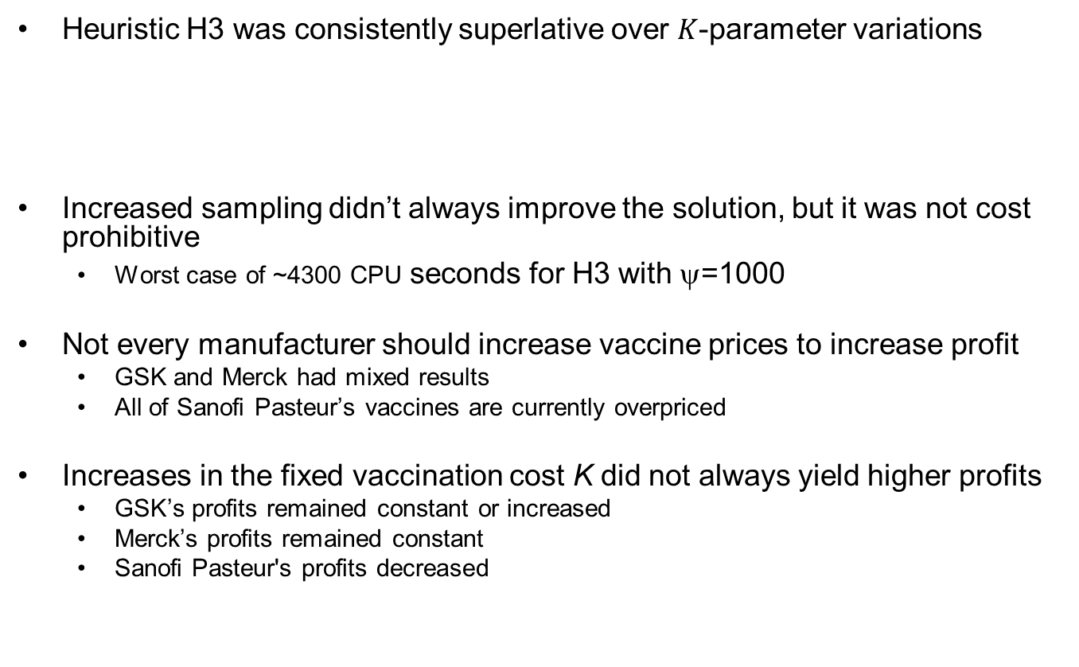
General Results
Heuristic H3 was consistently superlative over $K$-parameter variations
Increased sampling didn’t always improve the solution, but it was not cost prohibitive
Worst case of ~4300 CPU seconds for H3 with ψ=1000
Not every manufacturer should increase vaccine prices to increase profit
GSK and Merck had mixed results
All of Sanofi Pasteur’s vaccines are currently overpriced
Increases in the fixed vaccination cost K did not always yield higher profits
GSK’s profits remained constant or increased
Merck’s profits remained constant
Sanofi Pasteur's profits decreased
 | H1 | H1 | H1 | H2 | H2 | H2 | H3 | H3 | H3
 | ψ=10 | ψ=100 | ψ=1000 | ψ=10 | ψ=100 | ψ=1000 | ψ=10 | ψ=100 | ψ=1000
Avg. Gap (%) | 25.49 | 17.92 | 10.87 | 23.83 | 16.81 | 9.97 | 5.3 | 0.82 | 0
Max Gap (%) | 42.11 | 28.28 | 19.48 | 40.92 | 27.27 | 18.28 | 12.13 | 4.08 | 0

Slide 17
Conclusions and Recommendations
Depending on parametric fluctuations, a manufacturer acting unilaterally has the potential to increase profit per child completing the RCIS by
35% (from $231.84 to $312.55) for GlaxoSmithKline
47% (from $63.96 to $93.70) for Merck
866% (from $25.99 to $251.04) for Sanofi Pasteur
The methodology demonstrates an elegant combination of robust sampling and basic search theory to yield improved pricing solutions
Opens questions to consider regarding
Initiative in the private market
Informed and rational consumers

